Slide 1
INX Future Inc – Employee Performance Project
Data-Driven Analysis and Recommendations
By Elizabeth Cheruyot.

Slide 2
PROBLEM STATEMENT
INX faces declining employee performance and client satisfaction, requiring data-driven insights to identify root causes without harming employee morale or its reputation as a top employer.
PROJECT OBJECTIVES
Department wise performances
Top 3 Important Factors effecting employee performance
A trained model which can predict the employee performance based on factors as inputs.
Recommendations to improve the employee performance based on insights from analysis

Slide 3
DATA & PREPROCESSING
Dataset shape: 1200 rows, 28 columns
Numerical columns: 19
Categorical columns: 8
Missing values: 0
Target Feature column: Performance Rating
Deleted column: Employee Number

Slide 4
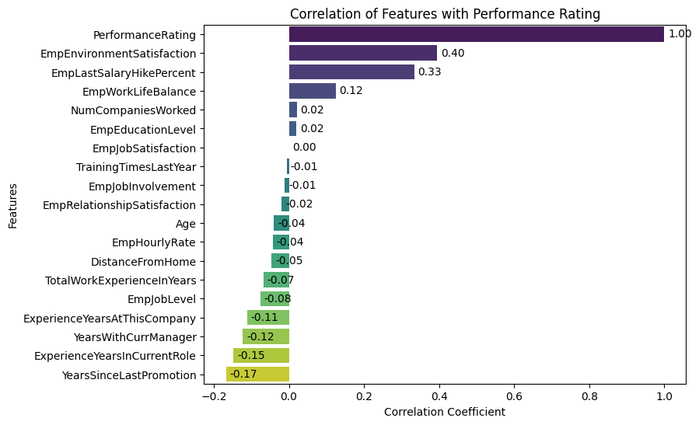
EXPLORATORY DATA ANALYSIS
Top positive drivers: Environment satisfaction, salary hikes, and work-life balance.
Negative drivers: Lack of promotions, being stuck in the same role or under the same manager.
Low/no impact: Education level, number of companies worked, training frequency.

Slide 5
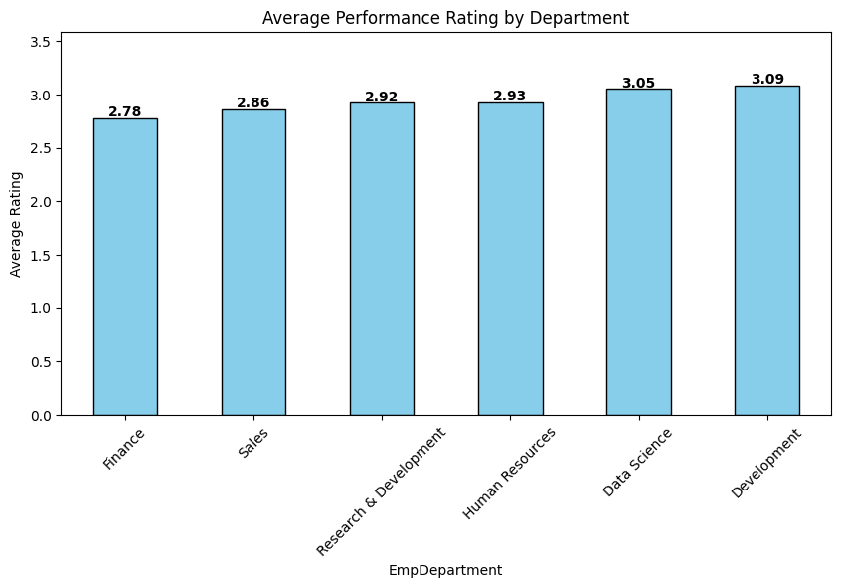
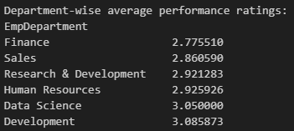
DEPARTMENT PERFORMANCE
Top-performing departments: Development (3.09) and Data Science (3.05) have the highest average performance ratings. Indicates these teams are consistently rated above the overall mean. This is a performance rating of Excellent.
Mid-level performers: Human Resources (2.93) and Research & Development (2.92) are just below 3.0, suggesting steady but not exceptional performance. This is a performance rating of Good, but just before Excellent.
Lowest-performing departments: Sales (2.86) and Finance (2.78) are at the bottom. This is a performance rating of Good.

Slide 6
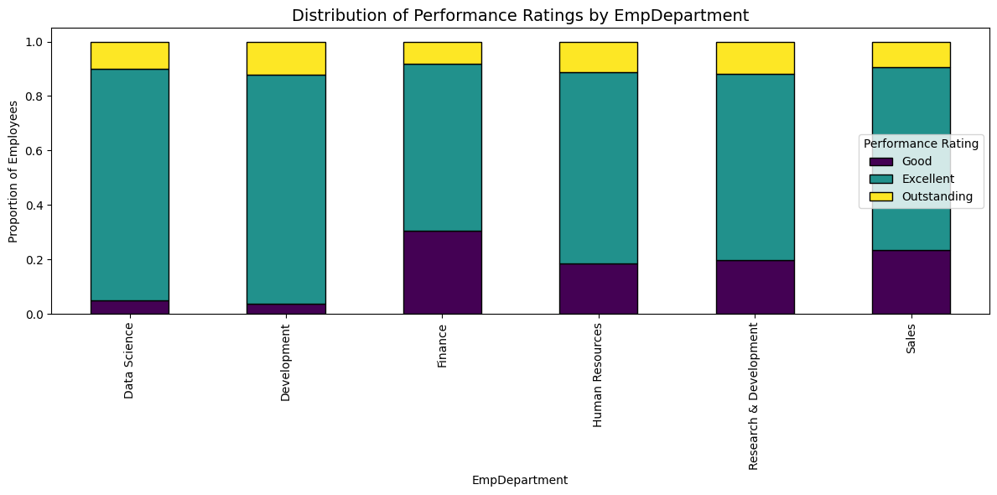
High performers: Data Science & Development are the strongest departments, should be leveraged as models.
Solid but mid-range: Research and Development & Human Resource departments are stable, but opportunities exist to move “Good” to “Excellent”.
At risk: Finance & Sales have larger proportions of “Good” employees, fewer top-rated staff. These teams likely need training, process changes, or stronger leadership support.
Notes:
**Business Implications**
- HR interventions should prioritize Finance and Sales for performance improvement.
- Development and Data Science departments could mentor or share best practices with weaker teams.
- Consider career progression and skill development programs in Finance and Sales to reduce the gap.

Slide 7
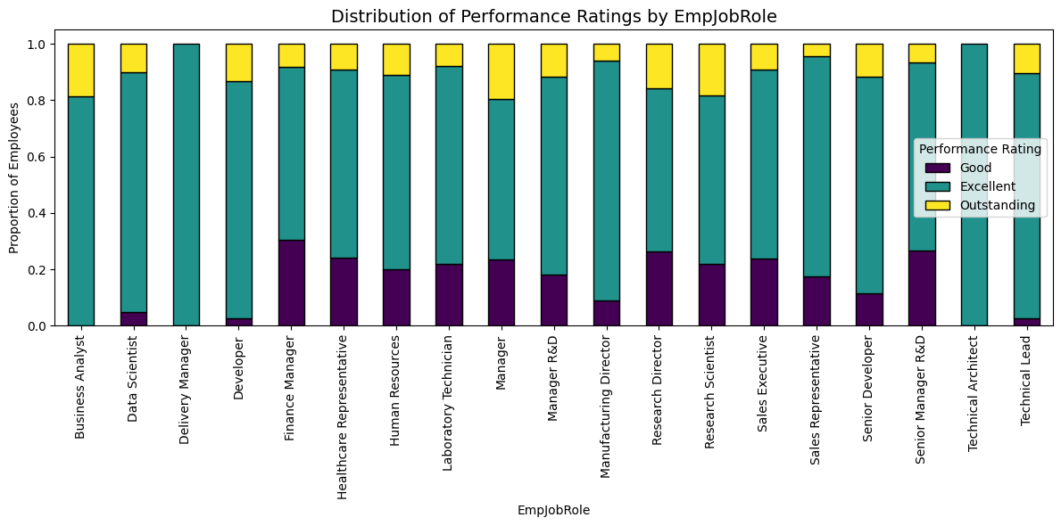
Technical/Analytical roles (Data Scientist, Developer, Technical Architect, Technical Lead) consistently show the highest performance.
Managerial/Support roles (Finance, HR, Healthcare, Lab Technicians) have more “Good” performers and fewer top ratings.
Sales-related roles (Sales Executive, Sales Representative) show variability, some Excellent, some Good, with fewer Outstanding.
Notes:
**Business Implications**
- Strengthen weak roles: Target Finance Managers, HR, Healthcare Reps, and Lab Technicians for capacity building.
- Leverage strong roles: Data Scientists and Developers can be showcased as benchmark performers and possibly mentors.
- Role-specific training: Tailor support by role instead of one-size-fits-all interventions.

Slide 8
PREDICTIVE MODELS
Models considered & Why:
Models | Key Strengths | Why Suitable for INX Project
Random Forest | Robust, reduces overfitting, interpretable feature importance | Helps identify key drivers of employee performance while maintaining stability
XGBoost | High accuracy, handles non-linear patterns, strong regularization | Captures complex relationships in employee data with better control of overfitting
LightGBM | Fast training, efficient on large/high-dimensional data, leaf-wise growth for accuracy | Scales to INX’s large dataset, providing quick and accurate insights
Together, these models balance accuracy, speed, and interpretability for INX’s employee “performance analysis.”
Initially I had considered having Logistic Regression and SVM which are powerful in some contexts. However, they lack the scalability, flexibility, and interpretability needed for INX’s large and complex employee dataset where the accuracy achieves was below 40% in comparison to ensemble classifiers (RF, XGBoost, LightGBM) which have the better fit.

Slide 9
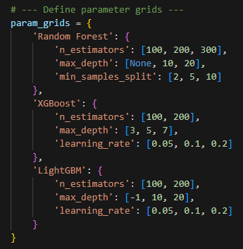
PREDICTIVE MODEL STEPS
Note: Although 4 categories exist in theory, this Performance Rate dataset only contains 3. The model is therefore trained to predict only Good, Excellent, and Outstanding.
Data Preprocessing
Prediction Model
Model Evaluation
Label Encoder
Standard Scaler
Train-test split (Test size:20%)
Define parameter grids for hypertuning
Define models & metrics
Perform hyper parameter tuning
Evaluate & pick the best models based on metrics
Confusion Matrix
Model Performance Comparison
Feature Importance
Evaluate the top Feature Importances based on best model
Metrics evaluation
Train
Model
Drop employee identifiers

Slide 10
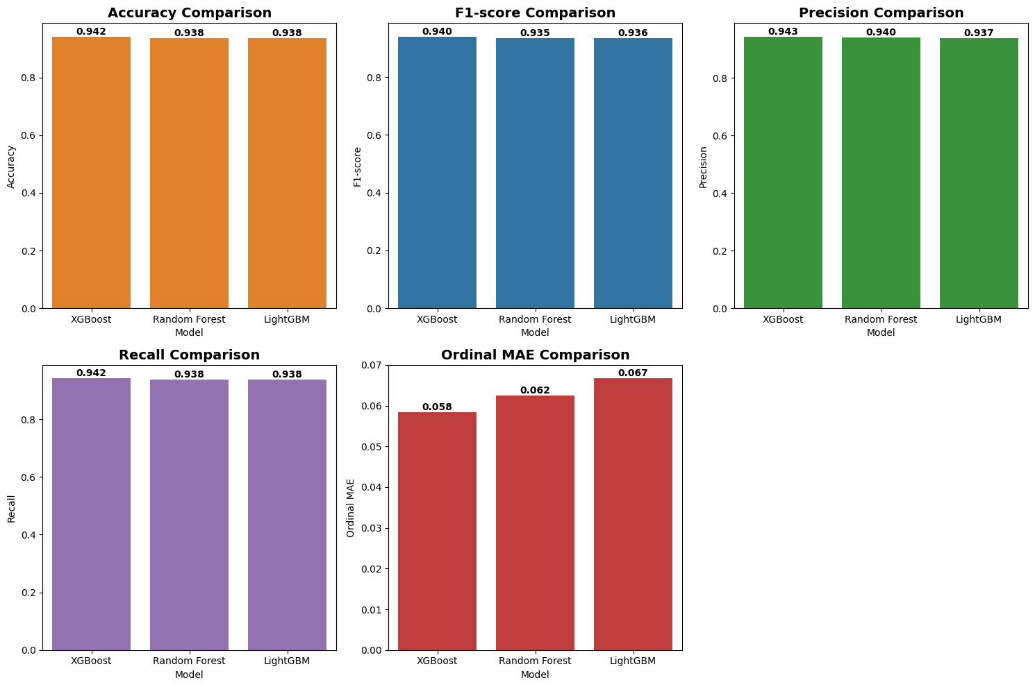
PREDICTIVE MODEL PERFORMANCE

Slide 11
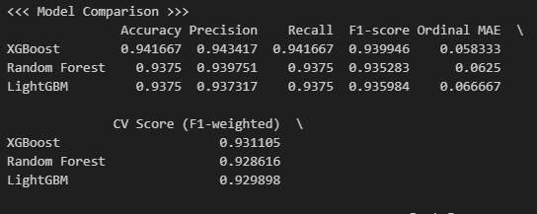
PREDICTIVE MODEL INSIGHT
XGBoost is recommended as the best model as it gives the most balanced trade-off between accuracy, error distance (Ordinal MAE), and generalization (CV F1).
XGBoost is slightly ahead across almost all metrics:
- Accuracy: 0.942 vs ~0.938 for others
- F1-score: 0.940 vs ~0.935 for others
- Ordinal MAE: 0.058 (lowest = best)
- CV Score (F1-weighted): 0.931 (highest = best).
Random Forest and LightGBM are very close, but XGBoost edges them out consistently.
Differences are small (≈0.003–0.004), but consistent across both single hold-out and cross-validation.

Slide 12
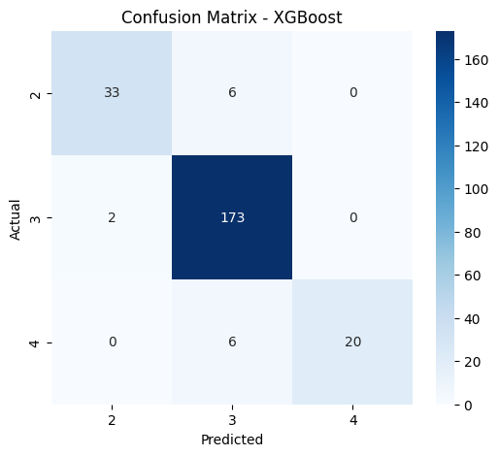
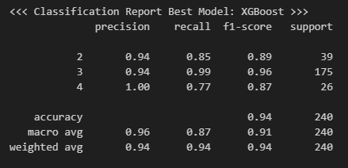
PREDICTIVE MODEL INSIGHT
Confusion Matrix
The XGBoost model is most reliable in identifying average performers (Class 3) with near-perfect recall (0.99). Low performers (Class 2) are predicted with high precision (0.94) but lower recall (0.85), while high performers (Class 4) are never falsely labeled (precision 1.00) but often under-recognized (recall 0.77).
Overall, the model is highly accurate but may require further parameter tuning to better capture top performers.

Slide 13
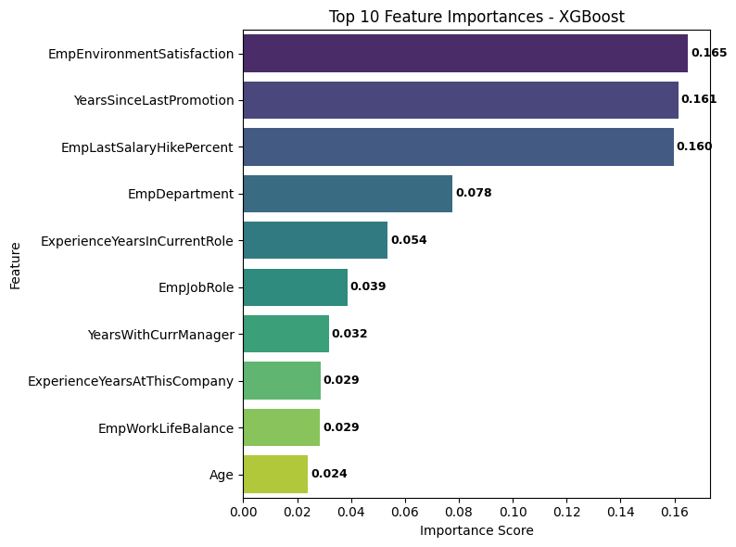
TOP 3 PERFORMANCE DRIVERS
1. Employee Environment Satisfaction
2. Years Since Last Promotion
3. Last Salary Hike Percentage
This highlights the critical role of workplace conditions, recognition, and compensation.
The findings suggest that improvements in workplace satisfaction, timely promotions, and fair salary adjustments are likely to have the greatest impact on enhancing employee performance.

Slide 14
INSIGHTS
Salary increments is linked to motivation. Those employees who had not received salary increments in years had lower ratings as compared to those who recently received salary increments.
The percentage of salary hike during salary increment play a vital role in motivating the employees. A low rating linked to lower hourly rate leads to a low salary increment, which in turn leads to demotivation of an employee.
Employees perform better when their working environment is of satisfactory. This applies to their comfortability to work in their respective spaces and also with their colleagues.
Years of experience in current role within a company makes one conversant with their work, their skills develop and their performance rating increases. Work-life balance strongly influences performance.
High Performing departments (Data Science and Development) consistently led in performance and should be leveraged as benchmark models for best practices. Low Performing departments (Finance and Sales) have fewer top performers and a higher share of average employees, signaling a need for targeted improvement and intervention.
Technical/Analytical roles consistently show the highest performance. Managerial/Support roles have more “Good” performers and fewer top ratings. Sales-related roles show variability, some Excellent, some Good, with fewer Outstanding.

Slide 15
RECOMMENDATIONS
Salary hikes should be linked to measurable performance, skills, and contribution. The process, benchmarks, and eligibility must be communicated transparently to all employees. Applying consistent rules across departments ensures fairness, builds trust, and reduces bias. Transparent and fair hikes boost morale, motivation, and retention.
Improvements in workplace satisfaction, timely promotions, recognition & reward programs and fair salary adjustments are likely to have the greatest impact on enhancing employee performance.
Performance peaks at mid-career stage. INX should focus on strong onboarding for new hires and re-skilling for long-tenure staff to maintain high productivity.
Strong department teams should mentor, mid-tier departments should be uplifted, and at-risk departments require targeted HR interventions.
Target low performing roles for capacity building. Tailored support and training by role instead of a one-size-fits-all intervention.
Talent Management: Employees stuck too long in one role/under one manager may need career rotation or growth opportunities.
Training Programs: Simply increasing training sessions doesn’t guarantee better performance, consider quality over quantity.
Improve the Work life balance, job satisfaction and opinion-based measurements to a 0-10 scale for better results and deeper insight.
Adopt a numeric performance rating scale (e.g., 1–10), mapped to meaningful categories (Good, Excellent, Outstanding). This improves analytical precision, enables trend tracking, and ensures comparability across teams.
Use predictive model in HR in tracking yearly performance rate and identify the areas the organization needs to work on in motivating the employees.

Slide 16
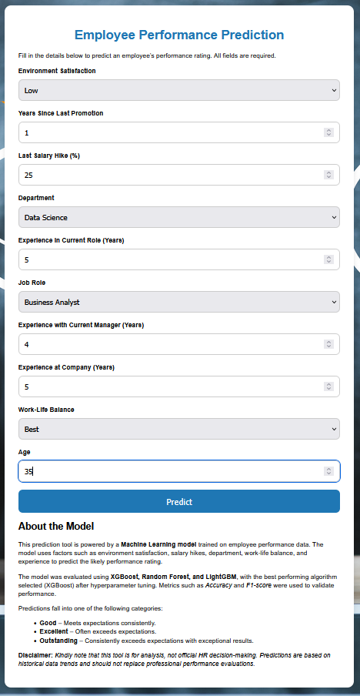
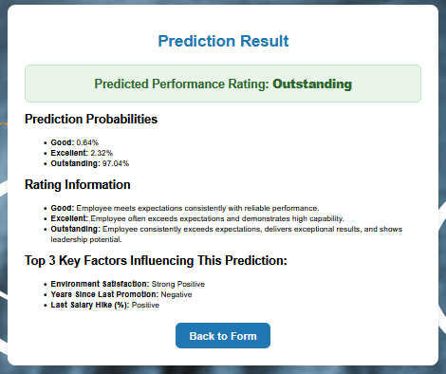
API DEPLOYMENT
Link: https://joangathu.pythonanywhere.com/
THANK YOU

